Slide 1
CRM Done Right
By Darrell K. Rigby and Dianne Ledingham

Slide 2
Tim = Introduction
Yifan = Company Overviews
Jesse = CRM cycle
Joey = Pros and Cons of CRM systems
Mike = Costs of CRM systems

Slide 3
Definition of CRM
Customer Relationship Management (CRM) is a broad term that covers concepts used by companies to manage their relationships with customers, including the capture, storage and analysis of customer information. www.greenwich-consulting.com/templates/gwcsimple.php

Slide 4
CRM sales rose by 28% from 1999 to 2000
CRM sales dropped by 5% in 2001
CRM sales dropped by 25% in 2002
CRM sales dropped by 17% in 2003
Source: Harvard Business Review

Slide 5
Companies Overviews
Several companies have implemented successful CRM efforts

Slide 6
Distill the experiences of the CRM leaders
Questions?
Is it strategic?
Where does it hurt?
Do we need perfect data?
Where do we go from here?

Slide 7
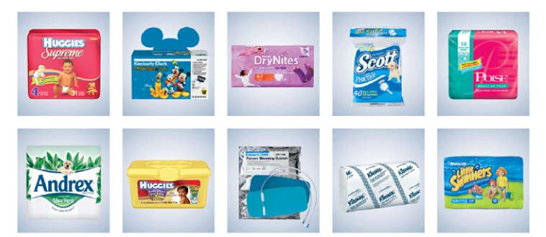


Companies have implemented successful CRM efforts
Aviall
Kimberly-Clark
Ingersoll-Rand
Brother International
Molex

Slide 8

Is It Strategic?
Paul Fulchino- CEO of Aviall
Knew the stakes involved (CRM – not a tool buffing a company – applied only to process vital to a company’s competitiveness )
Brought CRM into Aviall in 2000
Poor existing IT system – increase sales reps’ workloads
Inefficient phone call routing and haphazard calling schedules
A more focused approach > full-scale implementation of a broad CRM program
“ It is possible to use CRM systems to manage the entire customer relationship cycle, but that’s usually a bad idea.”

Slide 9

Where doest it hurt?
Examine customer relationship cycles – usually find some deep-seated problems
It is these pain points that should be the focus of the CRM effort
Kimberly-Clark – pain points – vast retailer promotions operation
Thousands of promotions every year – but unable to accurately gauge the success of any of them
Profit Calculator – more precisely measure the impact of a particular promotion on sales – renamed Business Planner – rapidly succeeded – manage more than 2,300 promotional events
“Focusing on pain points can not only be an effective way to build a successful CRM program but can also get an unsuccessful CRM initiative back on track. ”
Ingersoll-Rand: $10B diversified manufacturer
2001 Club Car showed signs of trouble – needed much better info – roll out a broad CRM system– too much for the org to digest
Refocused its CRM initiative on the two deepest pain points: forecasting sales and taking orders
Today: 2 yrs after CRM effort was relaunched – smoother, more predictable manufacturing schedules

Slide 10

Do we need perfect data?
Companies need to clearly distinguish b/n activities that truly demand perfect data and those that can get by with “good enough” info
Brother international – persistent problem: a high rate of prod returns – service representatives were failing to address recent buyer’s questions and complaints – frustrated customers were returning their products to retailers --pain point
CRM—bolster their call centers -- refine the system as it was implemented and adjust the training program as circumstances warranted
Used the right way, real-time info can help companies cope with high levels of complexity in their customer relationship cycle
Molex – larger customer base and a vast pipeline of potential orders
2002, installed a CRM system to manage its order pipeline
The gains were immediate: improved order mgt, better global coordination of inventory and pricing b/n regions

Slide 11
WHERE DO WE GO FROM HERE?
As Kimberly-Clark, Brother, and Molex found
The data produced by a narrowly focused CRM system – reveal additional opportunities for important business refinements
Those refinements – amount to a broad CRM application that extends across the company
It’s also often possible to extend the benefits of CRM to related business units
No longer a black hole, CRM is becoming a basic building block of corporate success

Slide 12
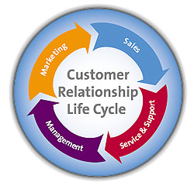
CRM Cycle
1
2
3
4
5
The series of activities that runs from the initial segmenting and targeting of customers all the way through to wooing them back for more.
When companies carefully examine their customer relationship cycles, they usually find some deep-seated problems in a few areas that undermine overall performance. These pain points are the focus of the CRM effort in the cycle.

Slide 13
CRM Cycle Factors
Strategic?
Where are our problems?
Is our information relevant?
What must be done first?
This is the realism incorporated in a CRM cycle to deploy its best advantages.

Slide 14
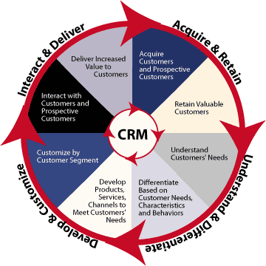
Customer Relationship Cycle
CRM system can automate every aspect of a companies relationship with its customers.
Smart companies focus their CRM implementations, carefully choosing which segment of the cycle and functions within that segment.

Slide 15
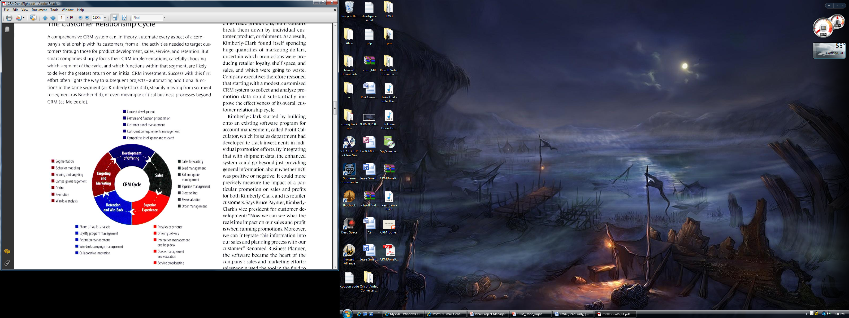
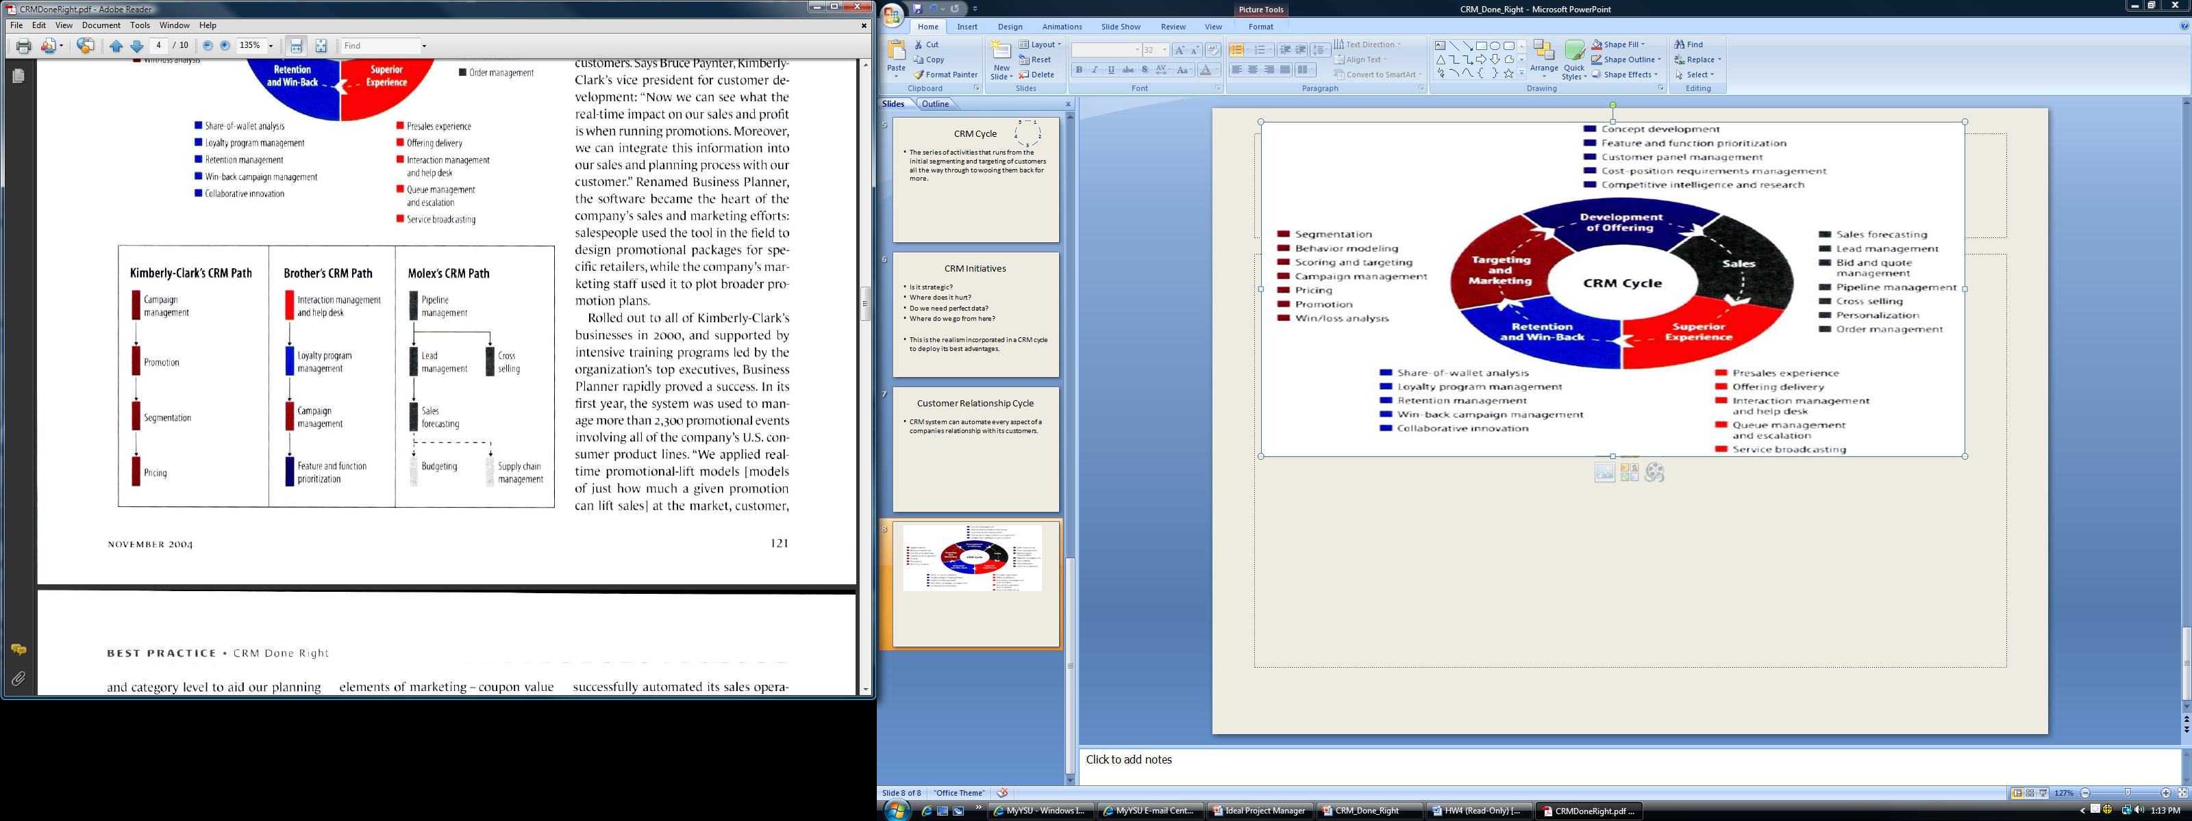

Slide 16
Overall CRM Cycle
Kimberly-Clark started with a modest, customized CRM system to collect and analyze promotion data that could substantially improve the effectiveness of its overall customer relationship cycle.
Brother’s CRP path enabled them to move from segment to segment to make them efficient and effective in the whole CRM cycle
Molex focused on the functions of their segment then moved to further the critical business processes beyond the CRM

Slide 17
Pros of CRM
New and better information
Information travels quicker
Get sales opportunities much earlier
Accurate sales targets
Improved global coordination of inventory and pricing in regions
Better data
  Improved budget planning

Slide 18
Pros of CRM
Get end to end view
  Upstream links for suppliers and downstream connections to the customers
Can be used to build an integrated enterprise for the customers
  Ingersoll-Rand wants to do this

Slide 19
Cons of CRM
Installation is not easy
Risks are involved
Costs a lot
No benefit if there is no clear performance measures and standards
Careful planning is involved which could take time
Needs attention

Slide 20
Calculating the Cost of CRM
Ace Grocery

Slide 21
Cost of CRM
Ace Grocery has a new competitor in town
  Newspaper Poll estimates 20% of Ace’s customers to switch
  Consultant estimates that 10% could be saved by offering them $100 in rewards
  Owner Todd Green debates his options
      Do Nothing
      Give $100 to everyone
      Reward just the right customers
      Purchase a CRM system

Slide 22

Cost of CRM
Do Nothing
Give $100 to Everyone
1,000 customers @ $1,000=
$1 million customer base
Retain only 80% of customers
Value drop to $800,000
Fewer customers lost
Expenses would likely decrease value to $800,000
  Todd begins to wonder if he could use CRM data to find precisely who would defect

Slide 23
Cost of CRM
Reward Just the Right Ones
Purchase a CRM System
$100 to ONLY the ones who will defect
Ace’s value will drop to $880,000
$80,000 = most Todd would pay for perfect information
$50,000 to purchase and implement CRM system
Only correctly identify 60% of potential defectors
  30% of loyal customers identified as defectors
Imperfect information = value drop to $774,000

Slide 24
Cost of CRM
Final Decision
Give every customer $100 in rewards
  Retain 900 customers
  Keep loyal customers happy

Slide 25
QUESTIONS?

